Slide 1
Customer Journey
Designed By Vinoth

Slide 2
Agenda
Customer Journey and Touchpoint
Data considering for Drop-off Analysis
Data Preprocessing and final dataset
Feature Extraction
Feature Analysis and Importance
Data irregularities
Model Building
Evaluation Techniques
Model Quality
Deliverable Insights

Slide 3
Customer Journey and Touchpoint
The customer journey is an essential part of your sales process because it’s ultimately your sales funnel. Understanding the exact process that a customer undergoes when they are researching, deciding, and purchasing from you is critical to knowing which buttons you need to push along the way.
An exercise that allows a brand to understand and improve a customer’s experience when they attempt to shop for their product. It tells the story of a person’s experience when they first start shopping for a product and continues through to the process of them purchasing a solution
Touchpoints are crucial for the customer to build enough trust in your store and make an informed purchase decision. (A touchpoint is defined as an interaction with your brand in some fashion. On-site touchpoints would be what we can track directly on your site. Off-site touchpoints are the interactions that happen with your brand off of your site (think social media)).
Divvit/ Google Analytics counts 5.5 touchpoints needed on average between our merchants and their customers before a purchase can be made. But what you need to understand is that each touchpoint is important because it’s an opportunity.

Slide 4
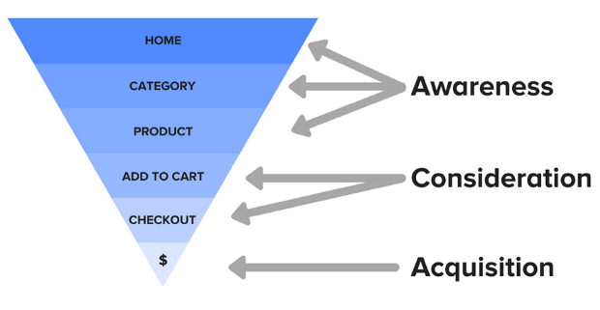
Awareness:
This is the moment when the customer first discovers you and your products. Usually upon the first click through to your site, they’re beginning to get a sense for who you are and what you have to offer.
Consideration:
During the consideration step, the customer is looking through your products and is starting to decide if they would like to purchase. This is typically one of the longer steps in the customer journey, as this is where all of those touchpoints happen.
Acquisition:
This is the conversion we’ve been hoping for! The customer has made their decision and has decided to checkout. From here, there are some other phases or steps towards reconversion, but that’s enough material for another article completely. We’ll focus on what we can track and measure for the first conversion.

Slide 5
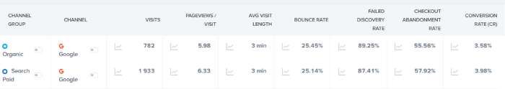
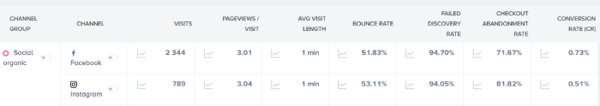
Data considering for Drop-off Analysis
Visits: how many people came to your site from this channel?
Page views/Visit: how many pages your customer viewed while on your site
Average Visit Length: how long a customer spent on your site?
Bounce Rate: how many visitors left your site without navigating past the landing page
Failed Discovery/Browse Abandonment Rate: how many visitors navigating through your site exited before adding anything to the cart?
Cart Abandonment Rate: how many customers added products to their carts but didn’t complete the purchase
Conversion Rate: how many customers made it to the acquisition phase?

Slide 6
Data Preprocessing and final dataset
EDA
Target Column
Missing Values
Column types
Anomalies
Correlations
Feature Engineering
Imputation
Handling Outlier
Binning
Encoding
Scaling
Feature Split
Feature Selection
Feature Selector
SelectKBest
RFE
Feature Selector
Find columns with a missing fraction greater than a specified threshold
Find features with only a single unique value
Find collinear features as identified by a correlation coefficient greater than a specified value
Find features with 0.0 importance from a gradient boosting machine
Find features that do not contribute to a specified cumulative feature importance from the gradient boosting machine

Slide 7
Model Building Steps
Load the data
Pre-process the data – Data cleaning and Data conversion
Feature Analysis & Extraction
Categorical encoding
Exploratory Data Analysis
Model fitting & Hyper-parameter tuning
Pick the best by evaluating the score
Evaluate with new data

Slide 8
Evaluation Metrics
Needed to select the best
Assess our model in terms of result
Provides Reliability to the model
Our Evaluation metrics – ROC AUC & F-Score

Slide 9
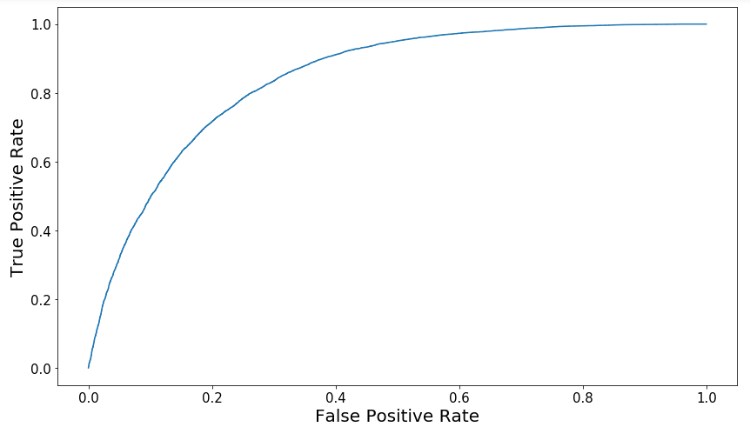
F-Score & ROC AUC
F-Score helps to evaluate both model performance and accuracy
Better measure for imbalanced data
ROC evaluates the misclassification of the model
ROC provides the better cut-off value to convert probability to decision
AUC helps to choose the best model for our requirement

Slide 10
What will be your final deliverable and Insights
Far less engaged (as seen in page views/visit and average visit length)
They find the message less relevant (as seen in the bounce rate)
They’re more likely to window-shop (as seen in a high failed discovery rate)
They’re far less ready to purchase (as seen in the checkout abandonment and conversion rates)
Typically visiting through mobile or tablet (more customers coming in from Facebook via mobile than they are via desktop, this can definitely account for some of the lower average visit times and page views)
They’re typically finishing their purchase via Google
ACTION PLAN
Anyone can say they want to make more revenue, but that doesn’t actually help you accomplish anything.
we need to define goals that make sense, and most importantly, they need to be measurable. Right now, we have a wealth of information at our fingertips: we know what KPIs we need to be concerned with, we know what channel to focus on, and we know what needs to be improved.

Slide 11

Any queries?

Slide 12
Thank you

